Slide 1



Data Science Project
Give me some credit!!!

Slide 2
The Brief
Improve on the state of the art in credit scoring by predicting the probability that somebody will experience financial distress in the next two years
Prize pool was $5,000 ($3,000 for first, $1,500 for second and $500 for third)
Winner of the competition was Perfect Storm
The scoring criteria which was to be used is the Area under the Curve.

Slide 3
Features
10 features
Revolving utilisation of unsecured lines
Age of the borrower
Debt Ratio
Monthly Income
Number of open credit lines
Number of dependents
Past performance of individual (3 variables)
Number of mortgage and real estate loans

Slide 4
My Approach
Data Cleaning
Focus on the model building
Cross Validation - Training & Test splits, Out-of-Bag and Grid Searching
Models attempted
Linear Discriminant Analysis
Logistic Regression
Classification Trees
Random Forests
Gradient Boosting

Slide 5
Data Cleaning
Missing data issues for monthly income and the number of dependants
Some basic methods such as median for income and mode for the number of dependants were employed. Ultimately more sophisticated approaches could have been investigated.
Late in the model development process, it was discovered that the debt ratio was not a ratio when the original data was missing. So a simple approach was to use the recalculate the debt ratio. This did help to improve the overall prediction.

Slide 6



Challenges
Learning the code
System overload
EC2 implementation
Large Elastic Compute Cloud significantly improved ability to generate results running large grids
Time

Slide 7

Model Building
Attempted to investigate a range of techniques
Grid Search proved to be very powerful, although computationally expensive
A crossed validated optimally pruned tree was surprising accurate (bias/variance, scalability)
Random Forests lead to improvements in AUC.
Gradient Boosting produced superior predictions

Slide 8
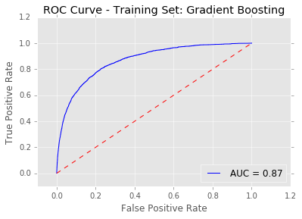
Results of the modelling process
Model | AUC (Kaggle)
LDA | N/A
Logistic Regression | 0.697912
CART | 0.848429
Random Forests | 0.852720
Gradient Boosting | 0.866799
925 teams
Best prediction ranked at #128
Sample entry benchmark #358 with AUC of 0.864249

Slide 9
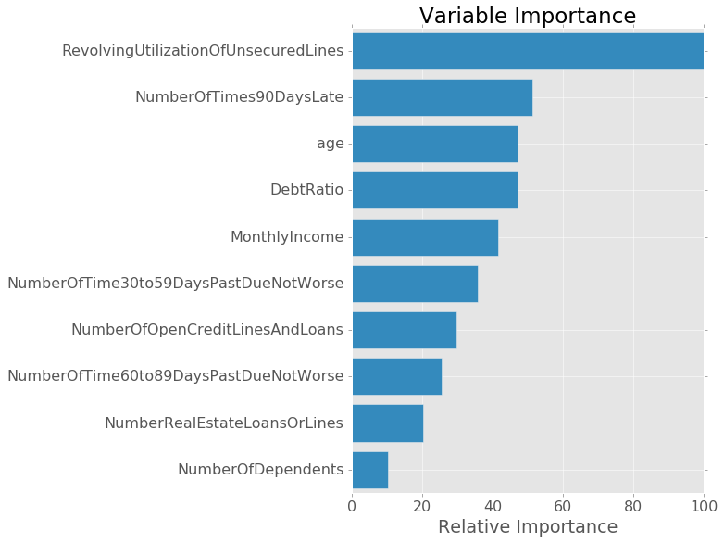
Variable Importance
Variable importance confirming some of our initial hypothesis.
The re-derivation of the debt ratio has resulted in a high relative importance for prediction
All variables resulting in non zero importance measures
One reason why regularization results were poor

Slide 10
For improvement
Did not get around to testing 2 other methods I would have liked.
Support Vector Machines
Neural Networks
Stacking models
Winning entrant stacked a number of models (Gradient Bosting, Random Forests and Neural Networks)
Improvements in Cross Validation searching, early stopping techniques
Visualisation (Reduction in deviance during model build)
Improvements to allow easy of use of models with new problems

Slide 11
What I learned
A lot of syntax!!. I would like to continue this to the point where I can code in the base language of python without thinking
Use of Github and Markdown
Amazon Web Services
Command line (windows and linux)

Slide 12
Thankyou

